Slide 1
Machine Learning- Regressions

Slide 2
Why do we use machine learning
Machine Learning is the field of study that gives computers the ability to learn without being explicitly programmed. —Arthur Samuel, 1959
A computer program is said to learn from experience E with respect to some task T and some performance measure P, if its performance on T, as measured by P, improves with experience E. —Tom Mitchell, 1997
Suppose , you want to filter spam emails – this is a Machine Learning program that can learn to flag spam.
Machine can learn to identify Spam and not-spam from examples of spam emails , identifies by users) and examples of regular emails.
The examples that the system uses to learn are called the training set.
In this case, the task T is to flag spam for new emails, the experience E is the training data, and the performance measure P needs to be defined; for example, you can use the ratio of correctly classified emails - this performance measure is called accuracy.

Slide 3
Why do we use machine learning
Traditional method to identify Spam is rule based.
We need to define ‘Spam’ – if email has text “4U,” “credit card,” “free,” and “amazing” in subject.
Long list of rules need to be defined.
Same Spam filter problem based on ML automatically learns which word and phases are good predictors of Spam by detecting unusual pattern.

Slide 4
Why do we use machine learning
Traditional method to identify Spam is rule based.
We need to define ‘Spam’ – if email has text “4U,” “credit card,” “free,” and “amazing” in subject.
Long list of rules need to be defined.
Need to update flag /rules for including new words.
Same Spam filter based on ML automatically learns which word and phases are good predictors of Spam by detecting unusual pattern.
ML based Spam automatically notices unusually frequent new word and classify them as Spam.

Slide 5
ML automatically adapt changes
To summarize, Machine Learning is great for:
• Problems for which existing solutions require a lot of hand-tuning or long lists of rules: one Machine Learning algorithm can often simplify code and perform better.
• Complex problems for which there is no good solution at all using a traditional approach: the best Machine Learning techniques can find a solution.
• Fluctuating environments: a Machine Learning system can adapt to new data.
• Getting insights about complex problems and large amounts of data.

Slide 6
Types of Machine Leraning
Machine learning can be classified based on the following :
Whether Human Supervision needed to train and test (Supervised, Unsupervised , Semi-supervised, Reinforcement Learning )
Whether or not Machine can learn incrementally or in a batch ( Online and Batch Learning)
Whether New data points are compared against existing data point or detect pattern in training data and build a model ( instance based and Model based)

Slide 7
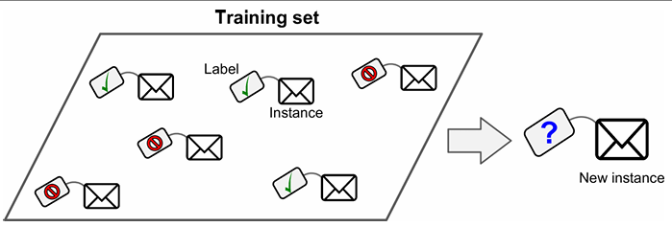
Supervised Learning - Classification
Machine Learning systems can be classified according to the amount and type of supervision they get during training.
In supervised learning, the training data you feed to the algorithm includes the desired solutions, called labels.
A typical supervised learning task is classification. The spam filter is a good example of this: it is trained with many example emails along with their class (spam or ham), and it must learn how to classify new emails.

Slide 8
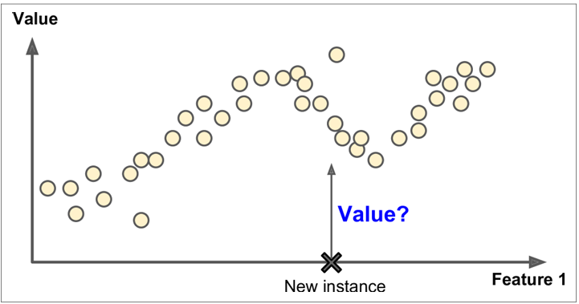
Supervised Learning – Regression
Model predict a target numeric value, such as the price of a car, given a set of features (mileage, age, brand, etc.) called predictors. This sort of task is called regression
Some regression algorithm can be used for classification as well and vice versa. Logistics regression can be used for classifying into classes.

Slide 9
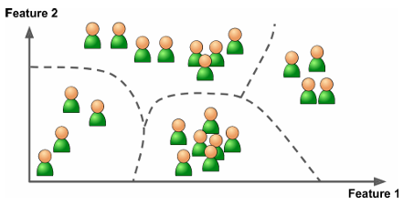
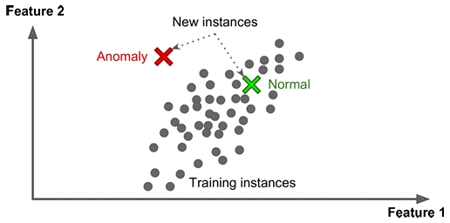
Unsupervised Learning
No supervision needed – System tries to learn without a teacher.
Clustering
- K-Means
DBSCAN
Hierarchical Cluster Analysis (HCA)
Anomaly detection and novelty detection
One-class SVM
Isolation Forest
For example, say you have a lot of data about your blog’s visitors. You may want to run a clustering algorithm to try to detect groups of similar visitors

Slide 10
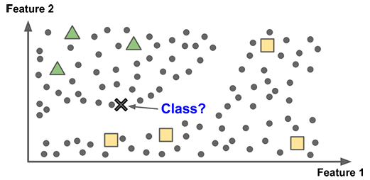
Semi supervised Learning
Some photo-hosting services, such as Google Photos, are good examples of this. It classifies or clusters photos into group based on same Person A appears in few photos and Person B appears in other photos. This is unsupervised.
Creating label against faces and then identifying person in photo is a supervised learning.

Slide 11
Bigger Problem
Let us take data set of house prices – California
This data has metrics such as the population, median income, median housing price, and so on for each block group in California.
Block groups are the smallest geographical unit for which the US Census Bureau publishes sample data (a block group typically has a population of 600 to 3,000 people). Those are known as “districts”.
What is the business objective? How does company expect to use and benefit from this model?

Slide 12
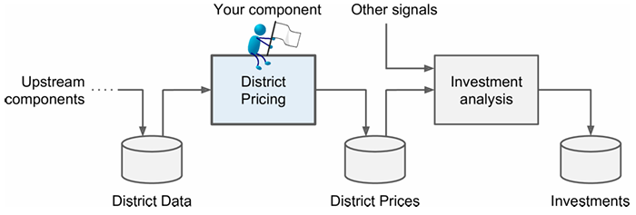
Bigger Problem
Assume that model’s output will be fed into another system along with other signals. The downstream system determines whether it is worth investing in a given arear or not.
A sequence of data processing components is called a data pipeline. Pipelines are very common in Machine Learning systems, since there is a lot of data to manipulate and many data transformations to apply.
If the data was huge, you could either split your batch learning work across multiple servers (using the MapReduce technique), or you could use an online learning technique instead.

